Slide 1
Fitting and Registration
02/15/11
Computer Vision
CS 543 / ECE 549
University of Illinois
Derek Hoiem

Slide 2
Announcements
HW 1 due today
HW 2 out on Thursday
Compute edges and find circles in image using Hough transform
Create dictionary of texture responses and use it to match texture images
Derive the EM algorithm for a mixture of multinomials
Estimate foreground and background color distributions using EM and segment the object using graph cuts

Slide 3
Fitting: find the parameters of a model that best fit the data
Alignment: find the parameters of the transformation that best align matched points

Slide 4
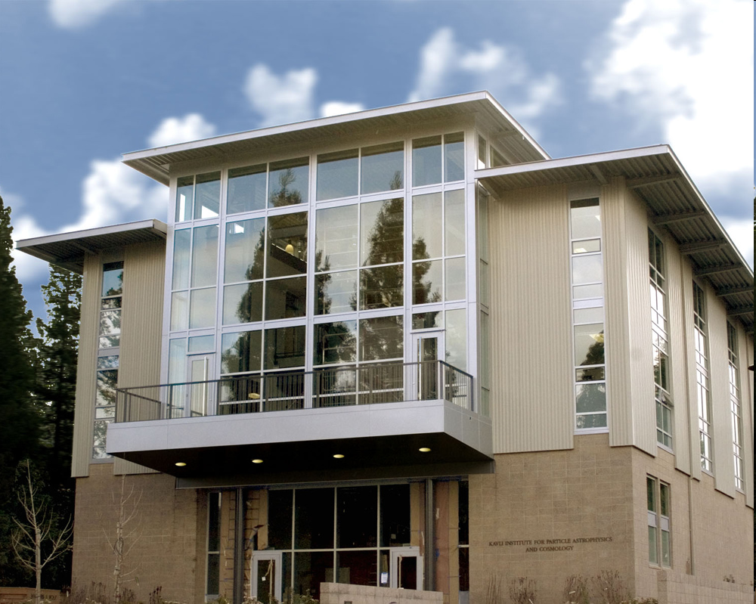
Example: Computing vanishing points
Slide from Silvio Savarese

Slide 5
Example: Estimating an homographic transformation
H
Slide from Silvio Savarese

Slide 6
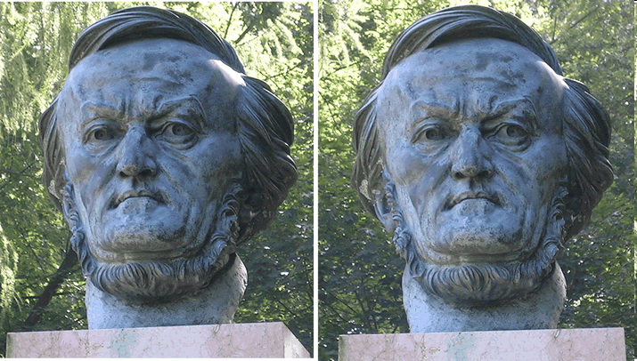
Example: Estimating “fundamental matrix” that corresponds two views
Slide from Silvio Savarese
Notes:
Assume that the intrinsic and extrinsic parameters of the cameras are known
We can multiply the projection matrix of each camera (and the image points) by the inverse of the calibration matrix to get normalized image coordinates
We can also set the global coordinate system to the coordinate system of the first camera

Slide 7
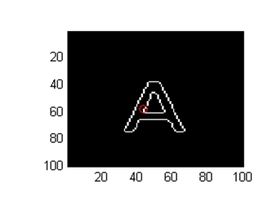
Example: fitting an 2D shape template
A
Slide from Silvio Savarese

Slide 8
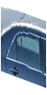
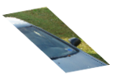
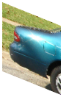
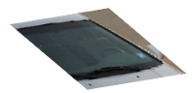
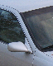
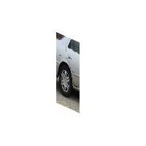

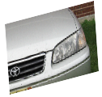
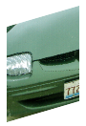
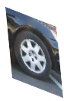

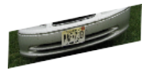

Example: fitting a 3D object model
Slide from Silvio Savarese
Notes:
As shown at the beginning, it interesting to visualize the geometrical relationship between canonical parts.
Notice that:
These 2 canonical parts share the same pose. All parts that share the same pose form a canonical pose.
These are other examples of canonical poses
Part belonging to different canonical poses are linked by a full homograhic transformation
Here we see examples of canonical poses mapped into object instances
%%
This plane collect canonical parts that share the same pose. All this canonical parts are related by a pure translation constraint.
- These canonical parts do not share the same pose and belong to different planes. This change of pose is described by the homographic transformation Aij.
- Canonical parts that are not visible at the same time are not linked.
Canonical parts that share the same pose forms a single-view submodel.
%Canonical parts that share the same pose form a single view sub-model of the object class. Canonical parts that do not belong to the same plane, correspond to different %poses of the 3d object. The linkage stucture quantifies this relative change of pose through the homographic transformations. Canonical parts that are not visible at the same %time are not linked.
Notice this representation is more flexible than a full 3d model yet, much richer than those where parts are linked by 'right to left', 'up to down‘ relationship, yet. . Also it is different from aspect graph: in that: aspect graphs are able to segment the object in stable regions across views

Slide 9
Critical issues: noisy data
Slide from Silvio Savarese

Slide 10
Critical issues: intra-class variability
“All models are wrong, but some are useful.” Box and Draper 1979
A
Slide from Silvio Savarese

Slide 11
Critical issues: outliers
H
Slide from Silvio Savarese

Slide 12
Critical issues: missing data (occlusions)
Slide from Silvio Savarese
Notes:
As shown at the beginning, it interesting to visualize the geometrical relationship between canonical parts.
Notice that:
These 2 canonical parts share the same pose. All parts that share the same pose form a canonical pose.
These are other examples of canonical poses
Part belonging to different canonical poses are linked by a full homograhic transformation
Here we see examples of canonical poses mapped into object instances
%%
This plane collect canonical parts that share the same pose. All this canonical parts are related by a pure translation constraint.
- These canonical parts do not share the same pose and belong to different planes. This change of pose is described by the homographic transformation Aij.
- Canonical parts that are not visible at the same time are not linked.
Canonical parts that share the same pose forms a single-view submodel.
%Canonical parts that share the same pose form a single view sub-model of the object class. Canonical parts that do not belong to the same plane, correspond to different %poses of the 3d object. The linkage stucture quantifies this relative change of pose through the homographic transformations. Canonical parts that are not visible at the same %time are not linked.
Notice this representation is more flexible than a full 3d model yet, much richer than those where parts are linked by 'right to left', 'up to down‘ relationship, yet. . Also it is different from aspect graph: in that: aspect graphs are able to segment the object in stable regions across views

Slide 13
Fitting and Alignment
Other challenges
Design a suitable goodness of fit measure
How can we be sure that we have the best?
Avoid local optima
How can we find the parameters quickly?
Find ways to avoid testing all parameters

Slide 14
Fitting and Alignment
Design challenges
Design a suitable goodness of fit measure
Similarity should reflect application goals
Encode robustness to outliers and noise
Design an optimization method
Avoid local optima
Find best parameters quickly

Slide 15
Fitting and Alignment: Methods
Global optimization / Search for parameters
Least squares fit
Robust least squares
Iterative closest point (ICP)
Hypothesize and test
Generalized Hough transform
RANSAC

Slide 16
Simple example: Fitting a line

Slide 17
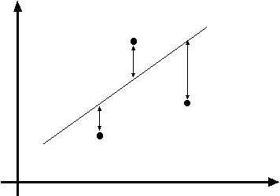
Least squares line fitting
Data: (x₁, y₁), …, (x_{n}, y_{n})
Line equation: y_{i} = m x_{i} + b
Find (m, b) to minimize
y=mx+b
(x_{i}, y_{i})
Matlab: p = A \ y;
Modified from S. Lazebnik

Slide 18
Problem with “vertical” least squares
Not rotation-invariant
Fails completely for vertical lines
Slide from S. Lazebnik

Slide 19
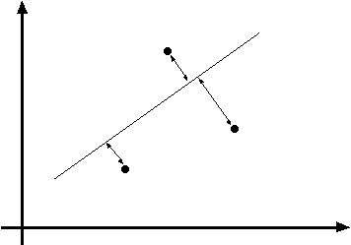
Total least squares
Slide modified from S. Lazebnik
If (a²+b²=1) then
Distance between point (x_{i}, y_{i}) is
|ax_{i} + by_{i} + c|
ax+by+c=0
Unit normal: N=(a, b)
(x_{i}, y_{i})
proof: http://mathworld.wolfram.com/Point-LineDistance2-Dimensional.html

Slide 20
Total least squares
Slide modified from S. Lazebnik
If (a²+b²=1) then
Distance between point (x_{i}, y_{i}) is
|ax_{i} + by_{i} + c|
Find (a, b, c) to minimize the sum of squared perpendicular distances
ax+by+c=0
Unit normal: N=(a, b)
(x_{i}, y_{i})

Slide 21
Total least squares
Slide modified from S. Lazebnik
Find (a, b, c) to minimize the sum of squared perpendicular distances
ax+by+c=0
Unit normal: N=(a, b)
(x_{i}, y_{i})
Solution is eigenvector corresponding to smallest eigenvalue of A^{T}A
See details on Raleigh Quotient: http://en.wikipedia.org/wiki/Rayleigh_quotient

Slide 22
Recap: Two Common Optimization Problems
Problem statement
Solution
(matlab)
Problem statement
Solution

Slide 23
Search / Least squares conclusions
Good
Clearly specified objective
Optimization is easy (for least squares)
Bad
Not appropriate for non-convex objectives
May get stuck in local minima
Sensitive to outliers
Bad matches, extra points
Doesn’t allow you to get multiple good fits
Detecting multiple objects, lines, etc.

Slide 24

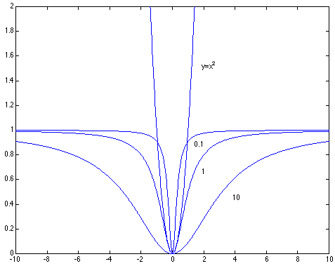
Robust least squares (to deal with outliers)
General approach:
minimize
u_{i} (x_{i}, θ) – residual of i^{th} point w.r.t. model parameters θ ρ – robust function with scale parameter σ
The robust function ρ
Favors a configuration
with small residuals
Constant penalty for large residuals
Slide from S. Savarese

Slide 25
Robust Estimator (M-estimator)
Initialize σ=0
Choose params to minimize:
E.g., numerical optimization
Compute new σ:
Repeat (2) and (3) until convergence

Slide 26
Demo – part 1

Slide 27
Hypothesize and test
Propose parameters
Try all possible
Each point votes for all consistent parameters
Repeatedly sample enough points to solve for parameters
Score the given parameters
Number of consistent points, possibly weighted by distance
Choose from among the set of parameters
Global or local maximum of scores
Possibly refine parameters using inliers

Slide 28
Hough transform
P.V.C. Hough, Machine Analysis of Bubble Chamber Pictures, Proc. Int. Conf. High Energy Accelerators and Instrumentation, 1959
Given a set of points, find the curve or line that explains the data points best
y
m
x
b
Hough space
y = m x + b
Slide from S. Savarese
Notes:
􀁑 Basic ideas
• A line is represented as . Every line in the image corresponds
to a point in the parameter space
• Every point in the image domain corresponds to a line in the parameter
space (why ? Fix (x,y), (m,n) can change on the line . In other
words, for all the lines passing through (x,y) in the image space, their
parameters form a line in the parameter space)
• Points along a line in the space correspond to lines passing through the
same point in the parameter space (why ?)

Slide 29
Hough transform
y
m
x
b
y
m
3
5
3
3
2
2
3
7
11
10
4
3
2
3
1
4
5
2
2
1
0
1
3
3
x
b
Slide from S. Savarese
Notes:
􀁑 Basic ideas
• A line is represented as . Every line in the image corresponds
to a point in the parameter space
• Every point in the image domain corresponds to a line in the parameter
space (why ? Fix (x,y), (m,n) can change on the line . In other
words, for all the lines passing through (x,y) in the image space, their
parameters form a line in the parameter space)
• Points along a line in the space correspond to lines passing through the
same point in the parameter space (why ?)

Slide 30
Hough transform
P.V.C. Hough, Machine Analysis of Bubble Chamber Pictures, Proc. Int. Conf. High Energy Accelerators and Instrumentation, 1959
Issue : parameter space [m,b] is unbounded…
Use a polar representation for the parameter space
y
x
Hough space
Slide from S. Savarese
Notes:
􀁑 Basic ideas
• A line is represented as . Every line in the image corresponds
to a point in the parameter space
• Every point in the image domain corresponds to a line in the parameter
space (why ? Fix (x,y), (m,n) can change on the line . In other
words, for all the lines passing through (x,y) in the image space, their
parameters form a line in the parameter space)
• Points along a line in the space correspond to lines passing through the
same point in the parameter space (why ?)

Slide 31
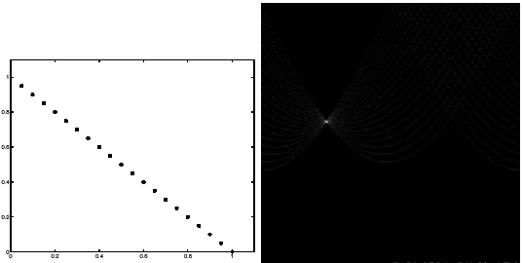
Hough transform - experiments
features
votes
Slide from S. Savarese
Notes:
Figure 15.1, top half. Note that most points in the vote array are very dark, because they
get only one vote.

Slide 32
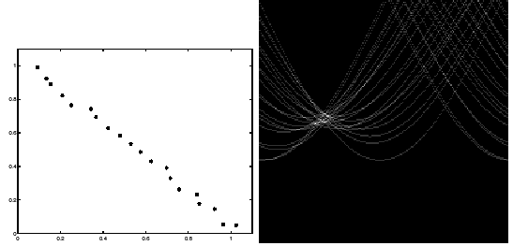
Hough transform - experiments
Noisy data
features
votes
Issue: Grid size needs to be adjusted…
Slide from S. Savarese
Notes:
This is 15.1 lower half

Slide 33
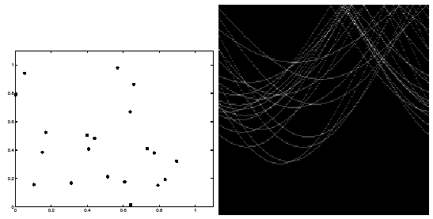
Hough transform - experiments
features
votes
Issue: spurious peaks due to uniform noise
Slide from S. Savarese
Notes:
15.2; main point is that lots of noise can lead to large peaks in the array

Slide 34
Hough transform
Fitting a circle (x, y, r)

Slide 35
Hough transform conclusions
Good
Robust to outliers: each point votes separately
Fairly efficient (much faster than trying all sets of parameters)
Provides multiple good fits
Bad
Some sensitivity to noise
Bin size trades off between noise tolerance, precision, and speed/memory
Can be hard to find sweet spot
Not suitable for more than a few parameters
grid size grows exponentially
Common applications
Line fitting (also circles, ellipses, etc.)
Object instance recognition (parameters are affine transform)
Object category recognition (parameters are position/scale)

Slide 36
RANSAC
(RANdom SAmple Consensus) :
Learning technique to estimate
parameters of a model by random
sampling of observed data
Fischler & Bolles in ‘81.
Model parameters
such that:
Source: Savarese
Notes:
Let me give you an intuition of what is going on. Suppose we have the standard line fitting problem in presence of outliers.
We can formulate this problem as follows: want to find the best partition of points in inlier set and outlier set such that…
The objective consists of adjusting the parameters of a model function so as to best fit a data set.
"best" is defined by a function f that needs to be minimized.
Such that the best parameter of fitting the line give rise to a residual error lower that delta
as when the sum, S, of squared residuals

Slide 37
RANSAC
_{(RANdom SAmple Consensus) :}
Fischler & Bolles in ‘81.
Algorithm:
Sample (randomly) the number of points required to fit the model
Solve for model parameters using samples
Score by the fraction of inliers within a preset threshold of the model
Repeat 1-3 until the best model is found with high confidence
Notes:
Let me give you an intuition of what is going on. Suppose we have the standard line fitting problem in presence of outliers.
We can formulate this problem as follows: want to find the best partition of points in inlier set and outlier set such that…
The objective consists of adjusting the parameters of a model function so as to best fit a data set.
"best" is defined by a function f that needs to be minimized.
Such that the best parameter of fitting the line give rise to a residual error lower that delta
as when the sum, S, of squared residuals

Slide 38
RANSAC
Line fitting example
Algorithm:
Sample (randomly) the number of points required to fit the model (#=2)
Solve for model parameters using samples
Score by the fraction of inliers within a preset threshold of the model
Repeat 1-3 until the best model is found with high confidence
Illustration by Savarese
Notes:
Let me give you an intuition of what is going on. Suppose we have the standard line fitting problem in presence of outliers.
We can formulate this problem as follows: want to find the best partition of points in inlier set and outlier set such that…
The objective consists of adjusting the parameters of a model function so as to best fit a data set.
"best" is defined by a function f that needs to be minimized.
Such that the best parameter of fitting the line give rise to a residual error lower that delta
as when the sum, S, of squared residuals

Slide 39
RANSAC
Line fitting example
Algorithm:
Sample (randomly) the number of points required to fit the model (#=2)
Solve for model parameters using samples
Score by the fraction of inliers within a preset threshold of the model
Repeat 1-3 until the best model is found with high confidence
Notes:
Let me give you an intuition of what is going on. Suppose we have the standard line fitting problem in presence of outliers.
We can formulate this problem as follows: want to find the best partition of points in inlier set and outlier set such that…
The objective consists of adjusting the parameters of a model function so as to best fit a data set.
"best" is defined by a function f that needs to be minimized.
Such that the best parameter of fitting the line give rise to a residual error lower that delta
as when the sum, S, of squared residuals

Slide 40
RANSAC
Line fitting example
Algorithm:
Sample (randomly) the number of points required to fit the model (#=2)
Solve for model parameters using samples
Score by the fraction of inliers within a preset threshold of the model
Repeat 1-3 until the best model is found with high confidence
Notes:
Let me give you an intuition of what is going on. Suppose we have the standard line fitting problem in presence of outliers.
We can formulate this problem as follows: want to find the best partition of points in inlier set and outlier set such that…
The objective consists of adjusting the parameters of a model function so as to best fit a data set.
"best" is defined by a function f that needs to be minimized.
Such that the best parameter of fitting the line give rise to a residual error lower that delta
as when the sum, S, of squared residuals

Slide 41
RANSAC
Algorithm:
Sample (randomly) the number of points required to fit the model (#=2)
Solve for model parameters using samples
Score by the fraction of inliers within a preset threshold of the model
Repeat 1-3 until the best model is found with high confidence
Notes:
Let me give you an intuition of what is going on. Suppose we have the standard line fitting problem in presence of outliers.
We can formulate this problem as follows: want to find the best partition of points in inlier set and outlier set such that…
The objective consists of adjusting the parameters of a model function so as to best fit a data set.
"best" is defined by a function f that needs to be minimized.
Such that the best parameter of fitting the line give rise to a residual error lower that delta
as when the sum, S, of squared residuals

Slide 42
How to choose parameters?
Number of samples N
Choose N so that, with probability p, at least one random sample is free from outliers (e.g. p=0.99) (outlier ratio: e )
Number of sampled points s
Minimum number needed to fit the model
Distance threshold δ
Choose δ so that a good point with noise is likely (e.g., prob=0.95) within threshold
Zero-mean Gaussian noise with std. dev. σ: t²=3.84σ²
 | proportion of outliers e
s | 5% | 10% | 20% | 25% | 30% | 40% | 50%
2 | 2 | 3 | 5 | 6 | 7 | 11 | 17
3 | 3 | 4 | 7 | 9 | 11 | 19 | 35
4 | 3 | 5 | 9 | 13 | 17 | 34 | 72
5 | 4 | 6 | 12 | 17 | 26 | 57 | 146
6 | 4 | 7 | 16 | 24 | 37 | 97 | 293
7 | 4 | 8 | 20 | 33 | 54 | 163 | 588
8 | 5 | 9 | 26 | 44 | 78 | 272 | 1177
modified from M. Pollefeys

Slide 43
RANSAC conclusions
Good
Robust to outliers
Applicable for larger number of parameters than Hough transform
Parameters are easier to choose than Hough transform
Bad
Computational time grows quickly with fraction of outliers and number of parameters
Not good for getting multiple fits
Common applications
Computing a homography (e.g., image stitching)
Estimating fundamental matrix (relating two views)

Slide 44
Demo – part 2

Slide 45
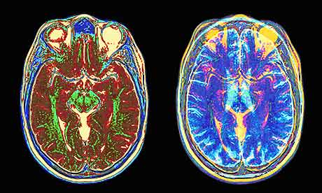
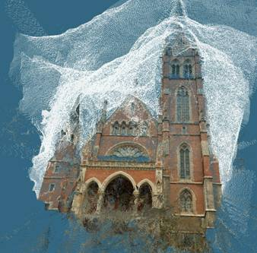
What if you want to align but have no prior matched pairs?
Hough transform and RANSAC not applicable
Important applications
Medical imaging: match brain scans or contours
Robotics: match point clouds

Slide 46
Iterative Closest Points (ICP) Algorithm
Goal: estimate transform between two dense sets of points
Assign each point in {Set 1} to its nearest neighbor in {Set 2}
Estimate transformation parameters
e.g., least squares or robust least squares
Transform the points in {Set 1} using estimated parameters
Repeat steps 2-4 until change is very small

Slide 47
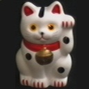
Example: solving for translation
A₁
A₂
A₃
B₁
B₂
B₃
Given matched points in {A} and {B}, estimate the translation of the object

Slide 48
Example: solving for translation
A₁
A₂
A₃
(t_{x}, t_{y})
B₁
B₂
B₃
Least squares solution
Write down objective function
Derived solution
Compute derivative
Compute solution
Computational solution
Write in form Ax=b
Solve using pseudo-inverse or eigenvalue decomposition

Slide 49
Example: solving for translation
A₁
A₅
B₄
A₂
A₃
(t_{x}, t_{y})
B₁
A₄
B₂
B₃
B₅
Problem: outliers
RANSAC solution
Sample a set of matching points (1 pair)
Solve for transformation parameters
Score parameters with number of inliers
Repeat steps 1-3 N times

Slide 50
Example: solving for translation
B₄
A₁
B₅
B₆
A₂
A₃
(t_{x}, t_{y})
B₁
A₄
B₂
B₃
A₅
A₆
Problem: outliers, multiple objects, and/or many-to-one matches
Hough transform solution
Initialize a grid of parameter values
Each matched pair casts a vote for consistent values
Find the parameters with the most votes
Solve using least squares with inliers

Slide 51
Example: solving for translation
(t_{x}, t_{y})
Problem: no initial guesses for correspondence
ICP solution
Find nearest neighbors for each point
Compute transform using matches
Move points using transform
Repeat steps 1-3 until convergence

Slide 52
Next class: Clustering
Clustering algorithms
K-means
K-medoids
Hierarchical clustering
Model selection

